Slide 1
Concurrency & threads
Julian Duque

Slide 2
Topics
Concurrency and parallelism
Implementing threads
Executorservice
Thread pool

Slide 3
Concurrency and parallelism
Concurrency
Concurrency means that an application is making progress on more than one task at the same time (concurrently). If the computer only has one CPU the application may not make progress on more than one task at exactly the same time, but more than one task is being processed at a time inside the application. It does not completely finish one task before it begins the next.

Slide 4
Concurrency and parallelism
Parallelism
Parallelism means that an application splits its tasks up into smaller subtasks which can be processed in parallel, for instance on multiple CPUs at the exact same time.

Slide 5
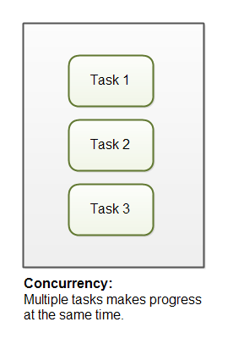
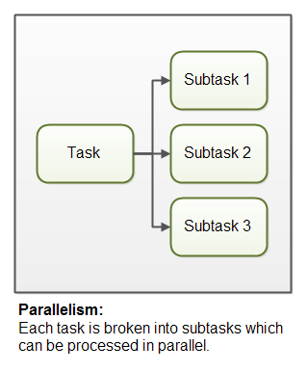
Concurrency and parallelism

Slide 6
Implementing threads
A thread is the smallest unit of execution that can be scheduled by the operating system. A process is a group of associated threads that execute in the same, shared environment. It follows, then, that a single-threaded process is one that contains exactly one thread, whereas a multi-threaded process is one that contains one or more threads.

Slide 7
Implementing threads
Introducing Runnable
is a functional interface that takes no arguments and returns no data.
@FunctionalInterface public interface Runnable {
void run();
}

Slide 8
Implementing threads
The following lambda expressions each rely on the Runnable interface:
() -> System.out.println("Hello World")
() -> {int i=10; i++;}
() -> {return;}
() -> {}

Slide 9
Implementing threads
Creating a Thread
The simplest way to execute a thread is by using the java.lang.Thread class, or Thread for short. Executing a task with Thread is a two-step process. First you define the thread with the corresponding task to be done. Then you start the task by using the Thread.start() method.

Slide 10
Implementing threads
Defining the task, or work, that a Thread instance will execute can be done two ways in Java:
Provide a Runnable object or lambda expression to the Thread constructor.
Create a class that extends Thread and overrides the run() method.

Slide 11
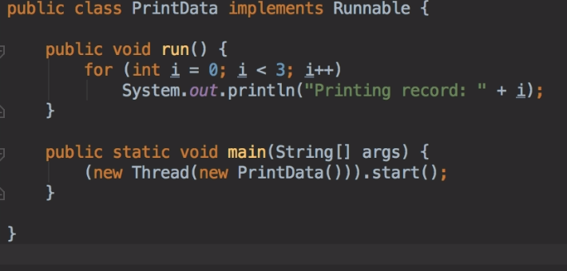
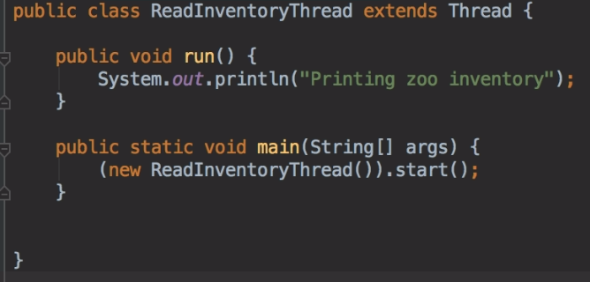
Implementing threads

Slide 12
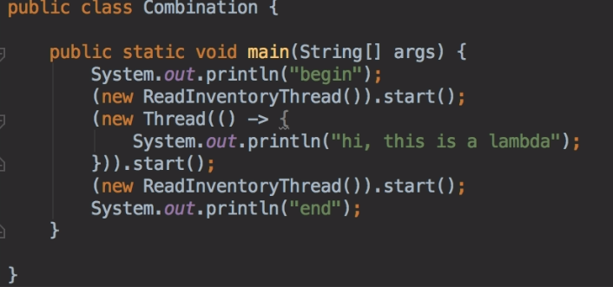
Implementing threads
The first example creates a Thread using a Runnable instance, while the second example uses the less common practice of extending the Thread class and overriding the run() method. Anytime you create a Thread instance, make sure that you remember to start the task with the Thread.start() method. This starts the task in a separate operating system thread. For example, what is the output of the following code snippet using these two classes?

Slide 13
ExecutorService
Creating Threads with the ExecutorService
With the announcement of the Concurrency API, Java introduced the ExecutorService, which creates and manages threads for you. You first obtain an instance of an ExecutorService interface, and then you send the service tasks to be processed

Slide 14
ExecutorService
Introducing the Single-Thread Executor
Since ExecutorService is an interface, how do you obtain an instance of it? The
Concurrency API includes the Executors factory class that can be used to create instances of the ExecutorService object

Slide 15
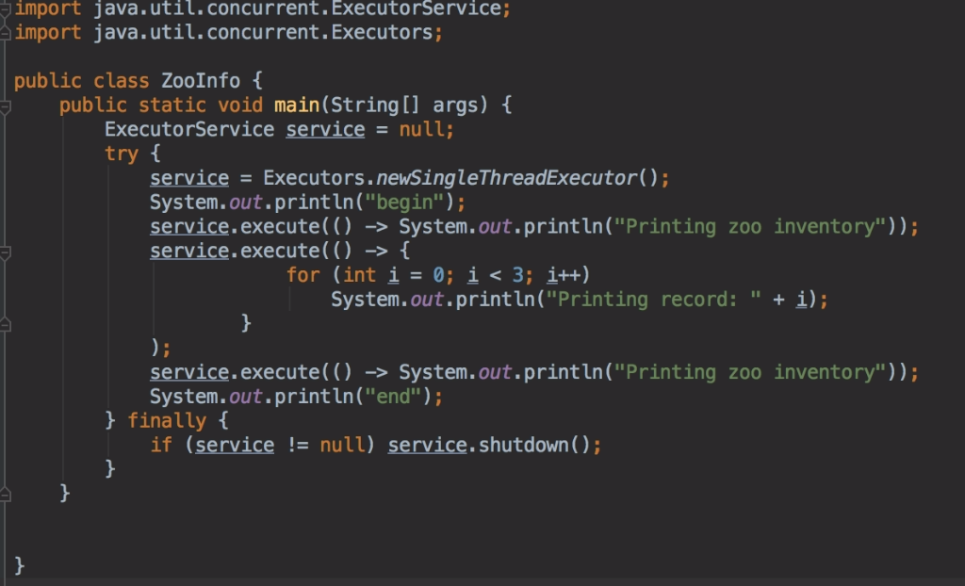
ExecutorService

Slide 16
ExecutorService
begin
Printing zoo inventory
Printing record: 0
Printing record: 1
end
Printing record: 2
Printing zoo inventory
With a single-thread executor, results are guaranteed to be executed in the order in which they are added to the executor service. Notice that the end text is output while our thread executor tasks are still running. This is because the main() method is still an independent thread from the ExecutorService, and it can perform tasks while the other thread is running.

Slide 17
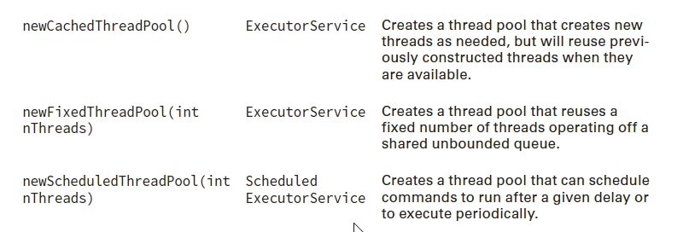
Thread pool
Increasing Concurrency with Pools
We now present three additional factory methods in the Executors class that act on a pool of threads, rather than on a single thread. A thread pool is a group of pre-instantiated reusable threads that are available to perform a set of arbitrary tasks.

Slide 18
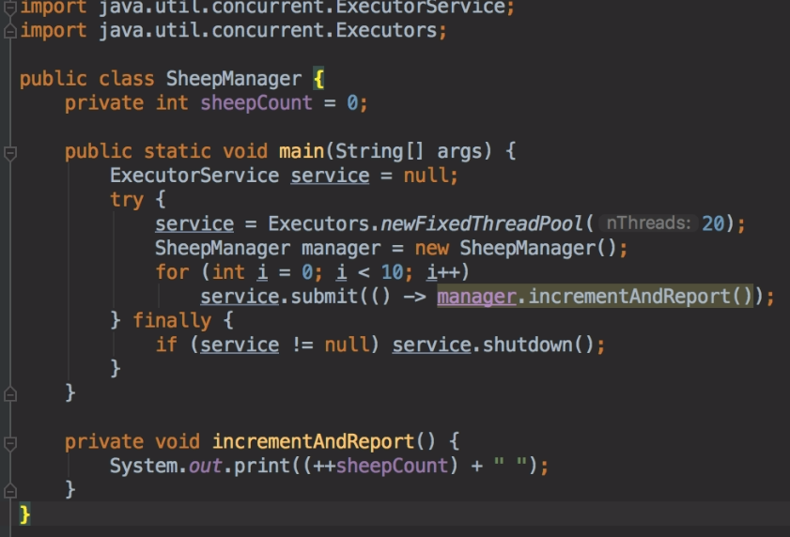
Thread pool

Slide 19
Improving Access with Synchronized Blocks
A monitor is a structure that supports mutual exclusion or the property that at most one thread is executing a particular segment of code at a given time. In Java, any Object can be used as a monitor, along with the synchronized keyword, as shown in the following example:
SheepManager manager = new SheepManager();
synchronized(manager) {
// Work to be completed by one thread at a time
}
This example is referred to as a synchronized block . Each thread that arrives will first check if any threads are in the block. In this manner, a thread “acquires the lock” for the monitor.

Slide 20
